Slide 1
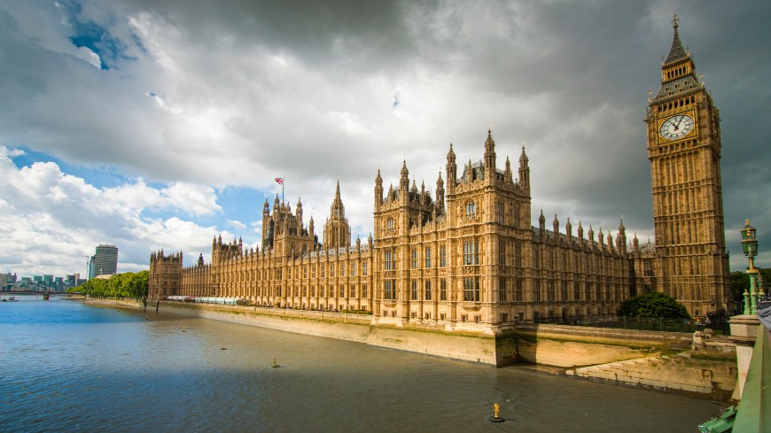
Do demographics determine our voting behaviour?
An analysis of the 2010 general election in England and Wales.

Slide 2
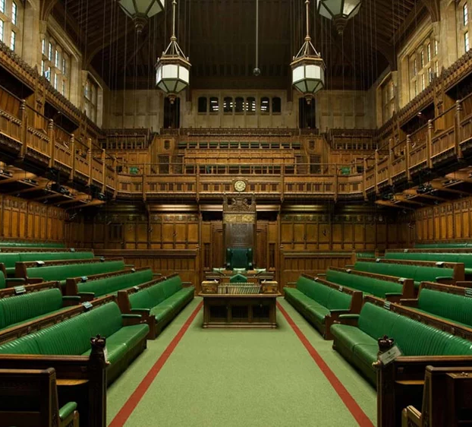
Background
Want to find out if your demographic background can impact how you vote in elections
If so – is the link strong enough to entirely determine who you will vote for.

Slide 3
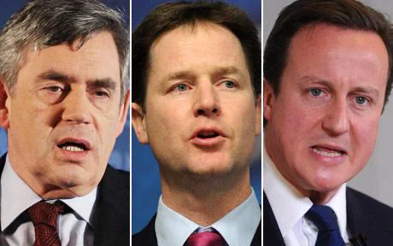
Context
2010 General Election
Labour were in government with a majority
Recession
Expenses scandal

Slide 4

Data
Census data from 2011 – from British Electoral Study and ONS
2010 General election – from BES

Slide 5
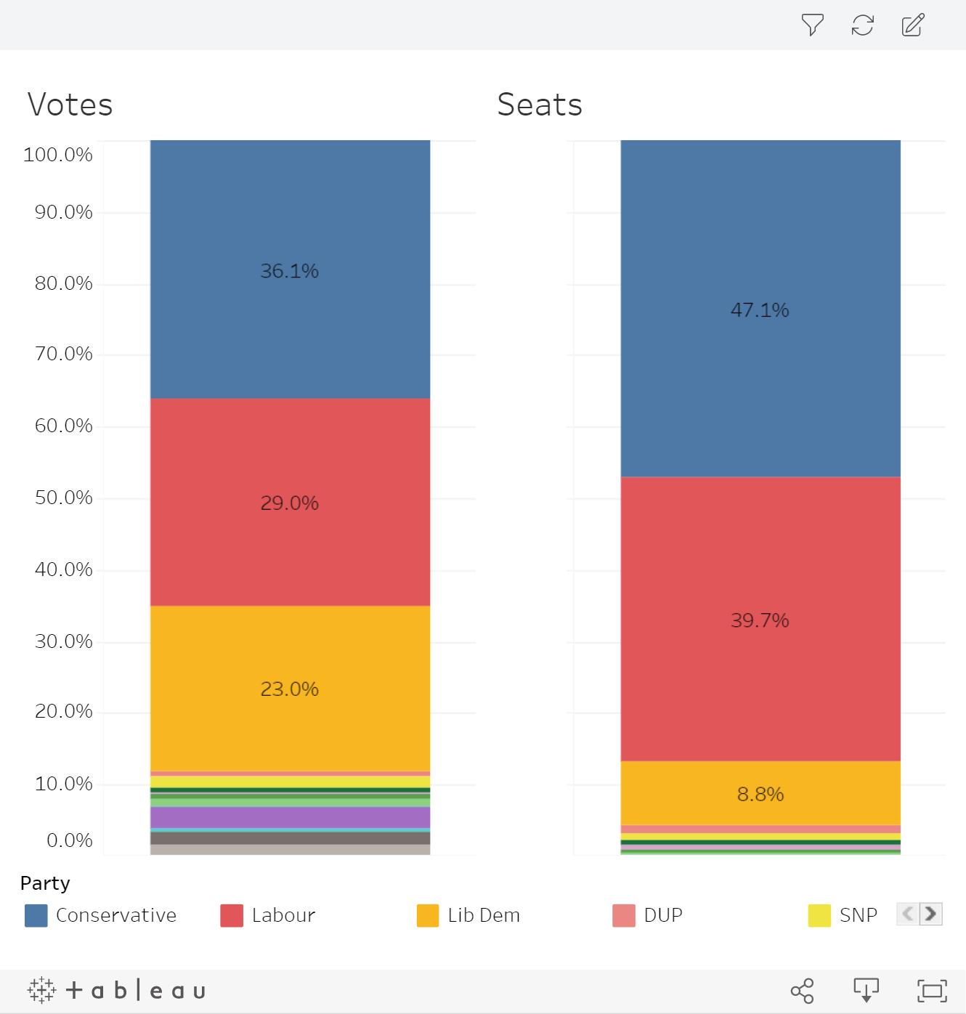
Election results
Conservatives – 306 seats
Labour – 258 seats
Liberal Democrats – 62 seats
Coalition formed between Liberal Democrats and Labour

Slide 6
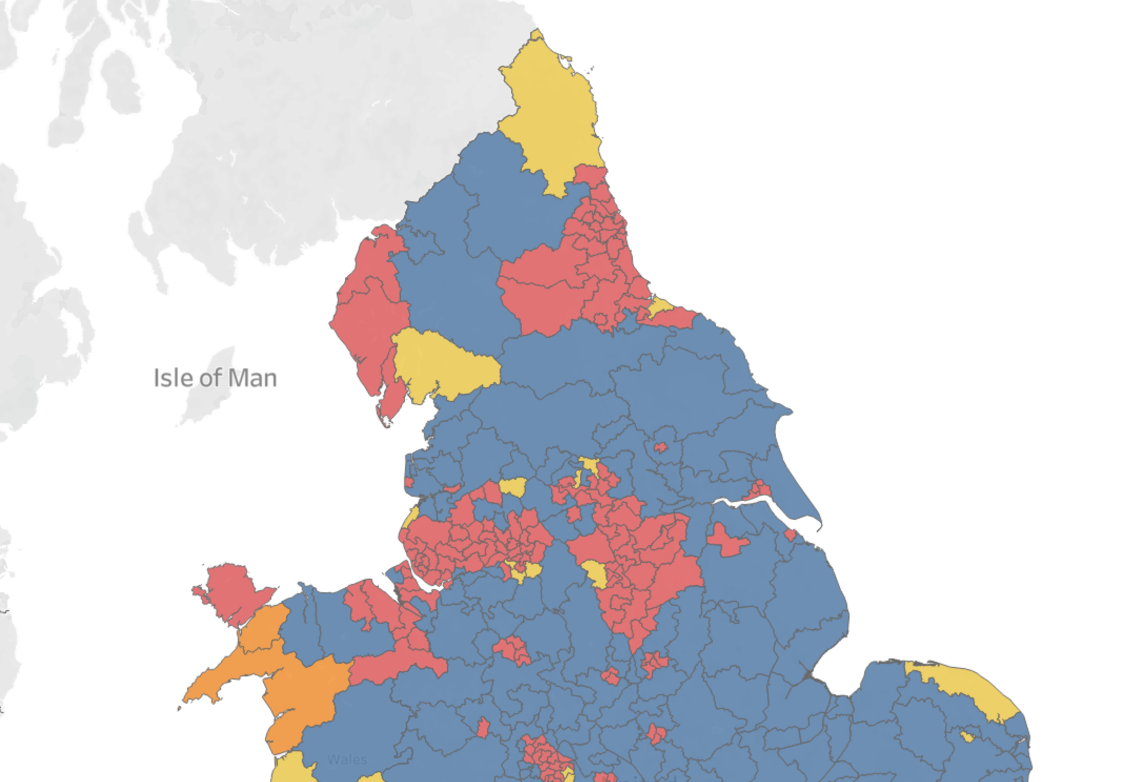
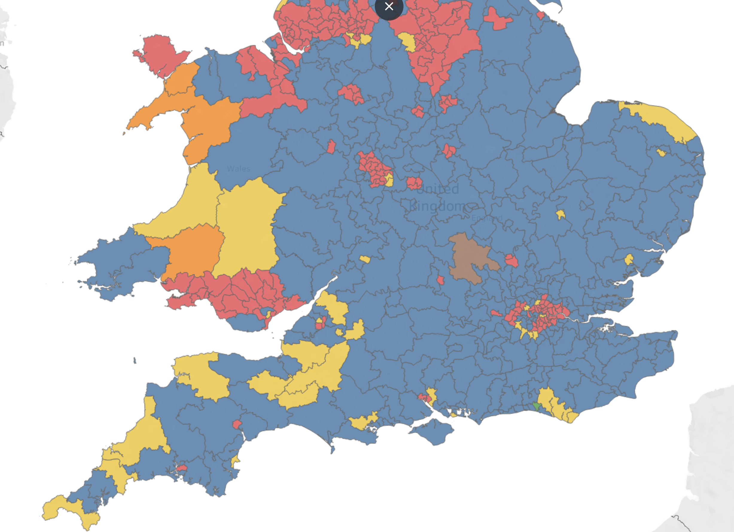
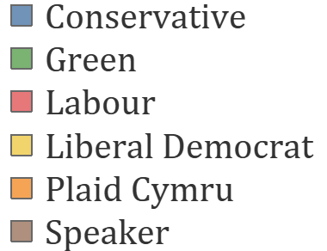

Slide 7
What does the average safe seat constituency look like?
 | Conservative | Labour | Lib Dem
House Price (£) | 252,400 | 156,100 | 226,700
Salary (£) | 29,860 | 24,999 | 27,720
White (%) | 93.1 | 73.6 | 95.0
Degree educated (%) | 30.4 | 22.8 | 33.4

Slide 8


Region
North vs South
Rural vs Cities

Slide 9
Region
North vs South

Slide 10
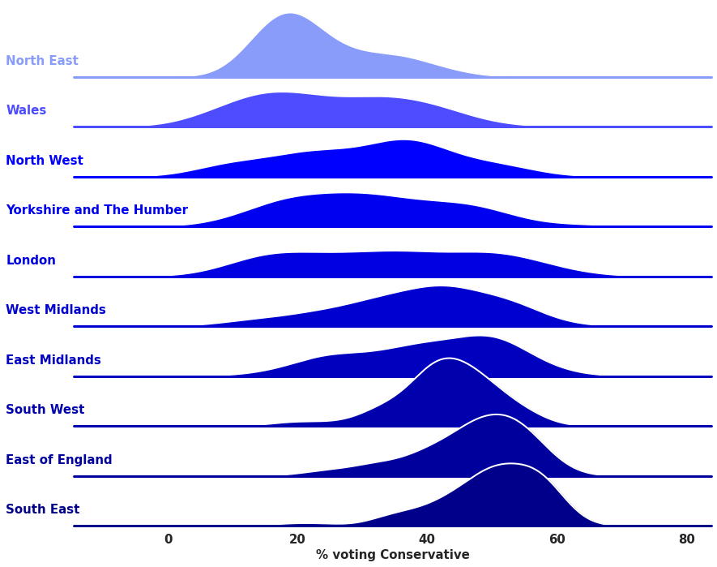
% voting Conservative

Slide 11
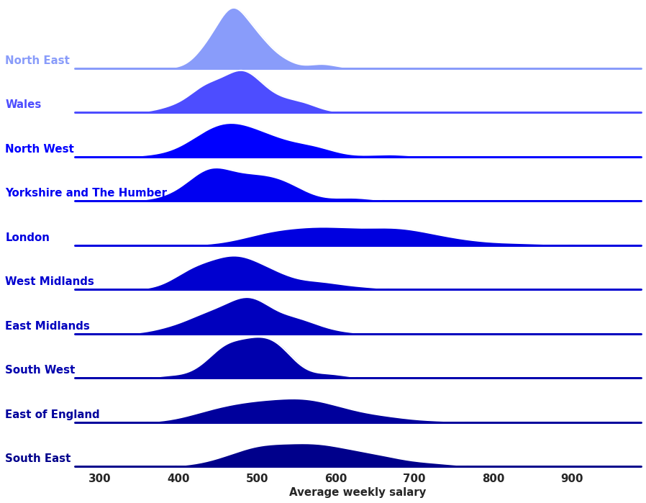
Average salary and voting behaviour
% voting Conservative
Average weekly salary

Slide 12
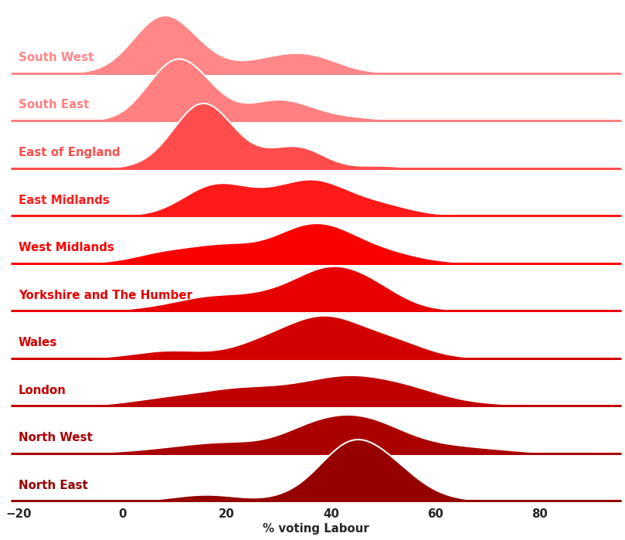
% voting Labour

Slide 13
Region
North vs South
Rural vs Cities

Slide 14
Region
Rural vs Cities

Slide 15
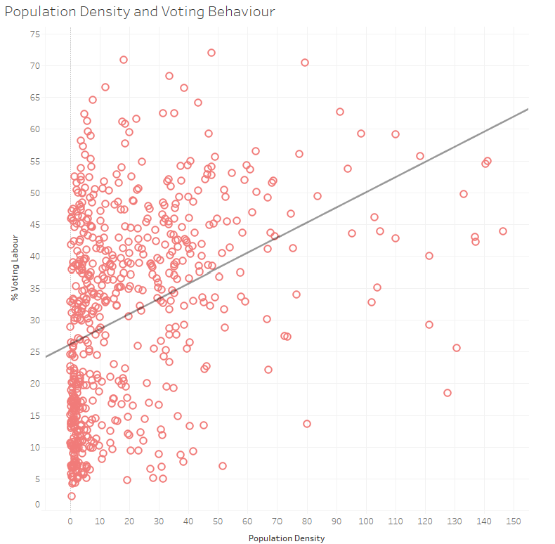
Population density and Voting Behaviour
% Voting Labour
Population Density

Slide 16
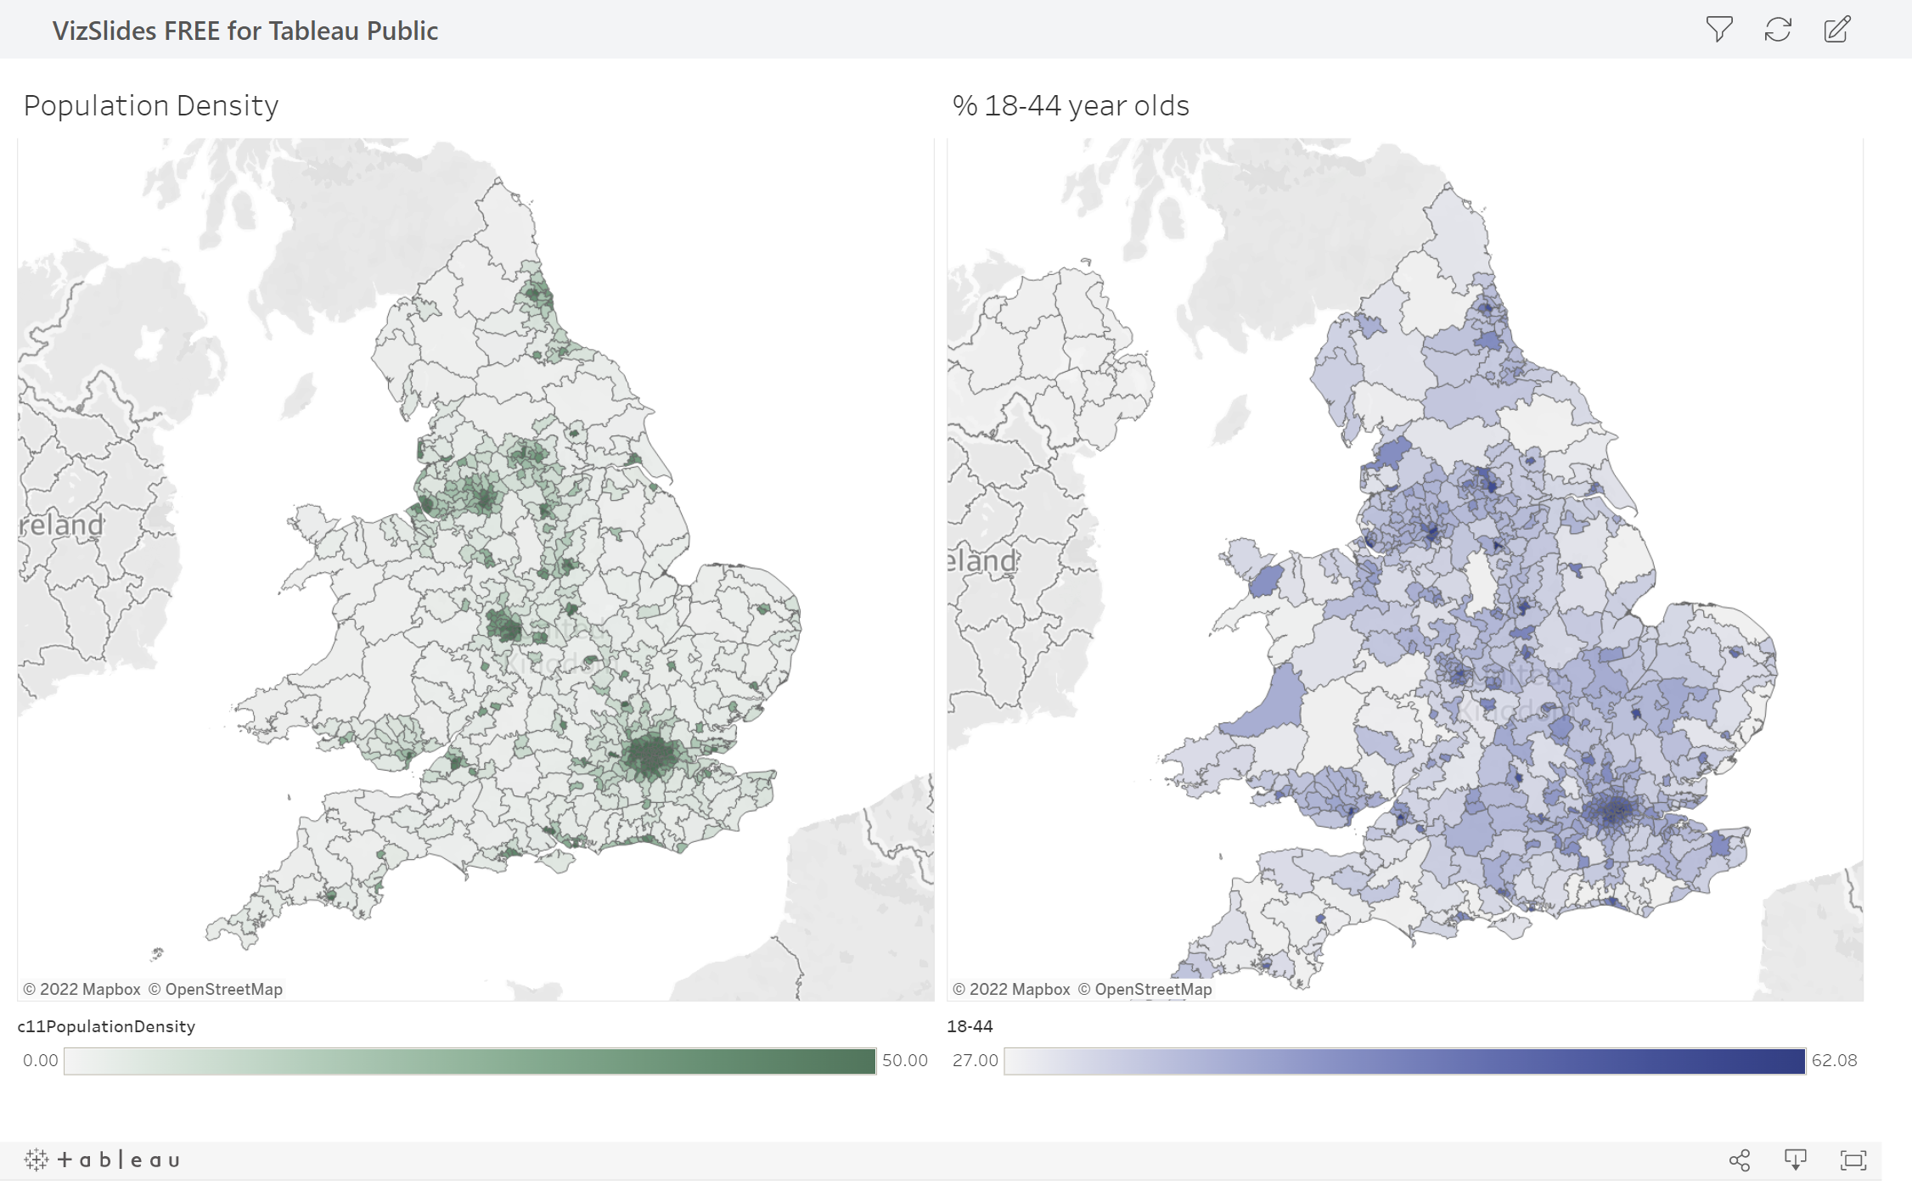

Slide 17
Age
Younger people tend to vote for left wing parties
Tuition fees
Environment
Progressive on social issues

Slide 18
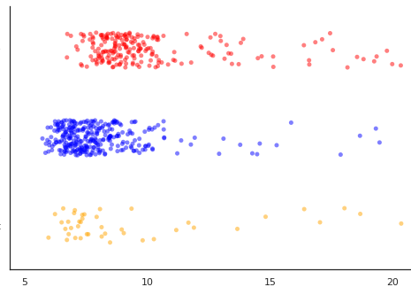
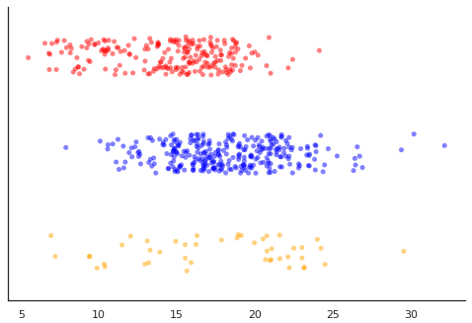
The population of Labour constituencies is younger
CON
LAB LIB DEM
% 18-24 year olds
% 65+ year olds

Slide 19
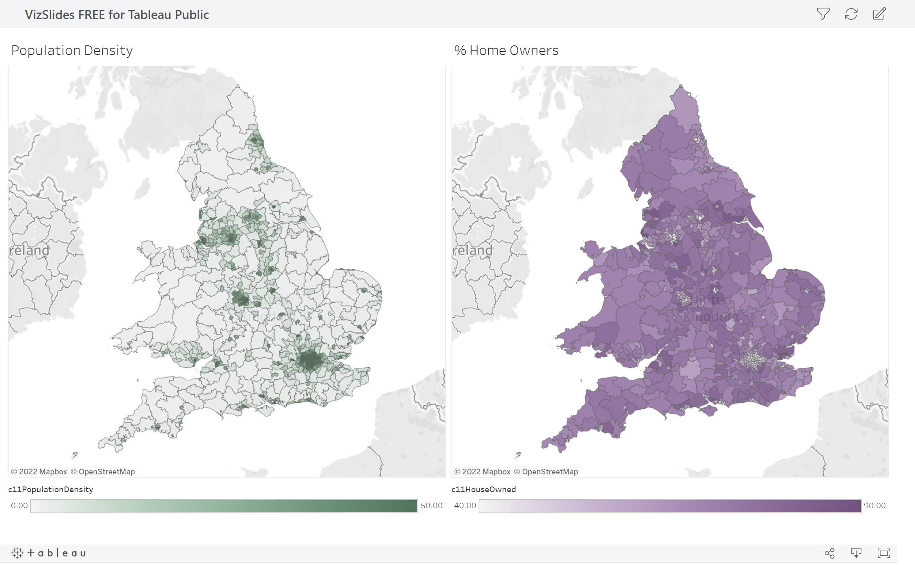

Slide 20
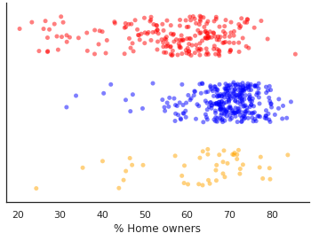
The population of Conservative Constituencies are more likely to be homeowners.
CON
LAB LIB DEM
Homeownership makes you financially independent – more anti-welfare.
More reliant on a stable house prices
% Home Owners

Slide 21
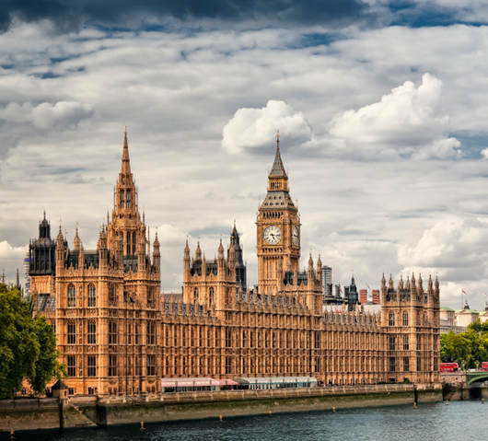
Summary
Demographics do impact how we vote – region, age and homeownership
Labour constituencies tend to be younger, more diverse, more densely populated
Conservative constituencies tend to be older, whiter, more rural, and have more homeowners

Slide 22
Why is this important?
This information is important for political parties, to know who their key voters are and which voters they could use more support from.
Demographics can be used to predict the outcome of elections.
Can help to predict what will happen to voting behaviour following a change in demographics.

